Slide 1
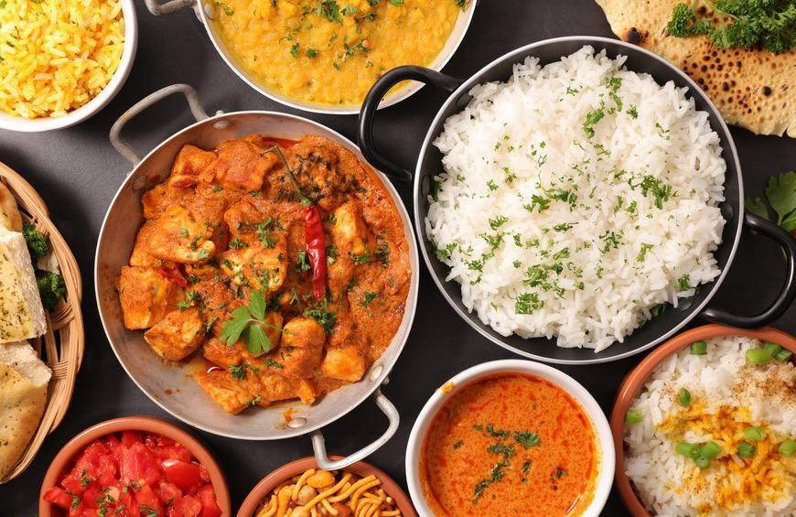
Exploring Toronto Neighbourhoods - To open a new Indian Restaurant
Capstone Project - The Battle of Neighborhoods
Amit Kumar Saha

Slide 2
Description of the Business Problem & Discussion of the Background:
Problem Statement: Prospects of opening an Indian Restaurant in Toronto, Canada.
Toronto, the capital of the province of Ontario, is the most populous Canadian city. Its diversity is reflected in Toronto’s ethnic neighborhoods such as Chinatown, Corso Italia, Greektown, Kensington Market, Koreatown, Little India, Little Italy, Little Jamaica, Little Portugal & Roncesvalles. One of the most immigrant-friendly cities in North America with more than half of the entire Indian Canadian population residing in Toronto it is one of the best places to start an Indian restaurant.

Slide 3
Target Audience
Who will be more interested in this project? What type of clients or a group of people would be benefitted?
Business personnel who wants to invest or open an Indian restaurant in Toronto. This analysis will be a comprehensive guide to start or expand restaurants targeting the Indian crowd.
Freelancer who loves to have their own restaurant as a side business. This analysis will give an idea, how beneficial it is to open a restaurant and what are the pros and cons of this business.
Indian crowd who wants to find neighborhoods with lots of option for Indian restaurants.
Business Analyst or Data Scientists, who wish to analyze the neighborhoods of Toronto using Exploratory Data Analysis and other statistical & machine learning techniques to obtain all the necessary data, perform some operations on it and, finally be able to tell a story out of it.

Slide 4
Data acquisition and cleaning
I’m using “List of Postal code of Canada: M” (https://en.wikipedia.org/wiki/List_of_postal_codes_of_Canada:_M) wiki page to get all the information about the neighbourhoods present in Toronto. This page has the postal code, borough & the name of all the neighbourhoods present in Toronto./en.m.wikipedia.org/wiki/Demographics_of_Toronto#Ethnic_diversity) wiki page. Using this page I’m going to identify the neighbourhoods which are densely populated with Indians as it might be helpful in identifying the suitable neighbourhood to open a new Indian restaurant.
To get location and other information about various venues in Toronto I’m using Foursquare’s explore API. Using the Foursquare’s explore API (which gives venues recommendations), I’m fetching details about the venues up present in Toronto and collected their names, categories and locations (latitude and longitude).
From Foursquare API (https://developer.foursquare.com/docs), I retrieved the following for each venue:
Name: The name of the venue.
Category: The category type as defined by the API.
Latitude: The latitude value of the venue.

Slide 5
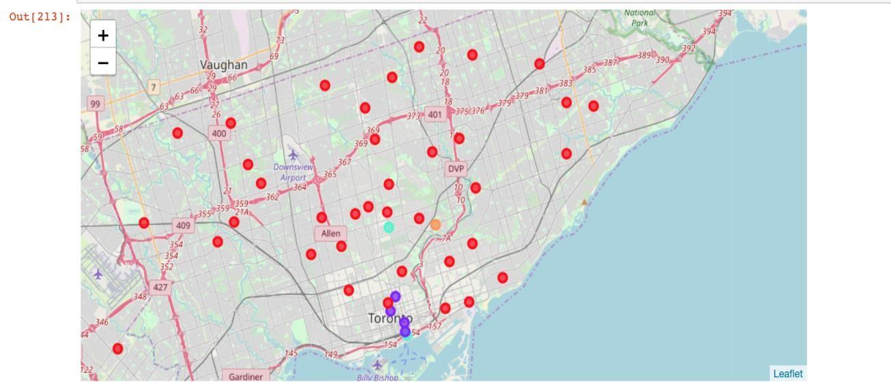
Folium map for the clusters of different neighbourhoods

Slide 6
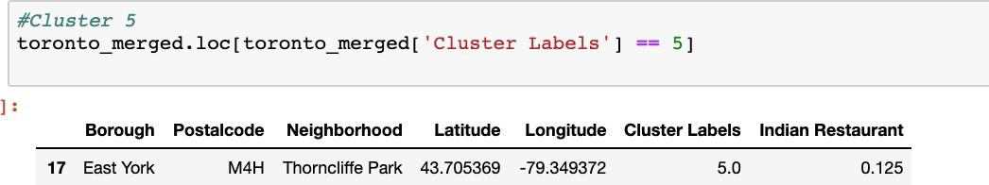
with the help of Violin plots between Number of Indian restaurants in Borough of Toronto.
In all the ridings,Scarborough-Agincourt etc are the densely populated with Indian crowd ridings.
restaurant’s location.
With the help of clusters examining & violin plots looks like Downtown Toronto, Central Toronto, East York are already densely populated with Indian restaurants. So it is better idea to leave those boroughs out and consider only Scarborough, East Toronto & North York for the new restaurant’s location.
After careful consideration it is a good idea to open a new Indian restaurant in Scarborough borough since it has high number of Indian population which gives a higher number of customers possibility and lower competition since very less Indian restaurants in the neighbourhoods.

Slide 7
Conclusion
Finally to conclude this project, We have got a chance to on a business problem like how a real like data scientists would do. We have used many python libraries to fetch the data , to manipulate the contents & to analyse and visualize those datasets. We have made use of Foursquare API to explore the venues in neighbourhoods of Toronto, then get good amount of data from Wikipedia which we scraped with help of Wikipedia python library and visualized using various plots present in seaborn & matplotlib. We also applied machine learning technique to predict the output given the data and used Folium to visualize it on a map.
Some of the drawbacks or areas of improvements shows us that this analysis can be further improved with the help of more data and different machine learning technique. Similarly we can use this project to analysis any scenario such as opening a different cuisine restaurant or opening of a new gym and etc. Hopefully, this project helps acts as initial guidance to take more complex real-life challenges using data-science.

Slide 8
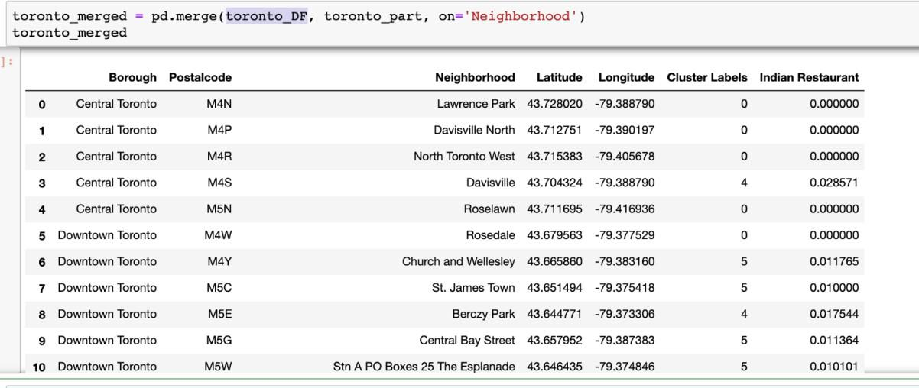
Exploratory Data Analysis:
This dataframe with the Toronto DataFrame with latitude & longitude information on neighbourhood. Finally extract just the Indian restaurant values along with neighbourhood information.

Slide 9
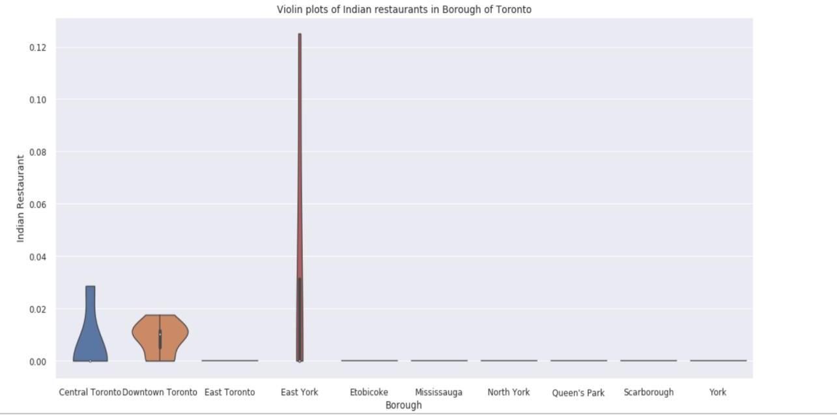
Identifying the boroughs with densely populated Indian restaurants.
With the help of this violin plots we can identify the boroughs with densely populated Indian restaurants. It is drawn using seaborn library to show distribution of Indian restaurants in different boroughs.
the

Slide 10
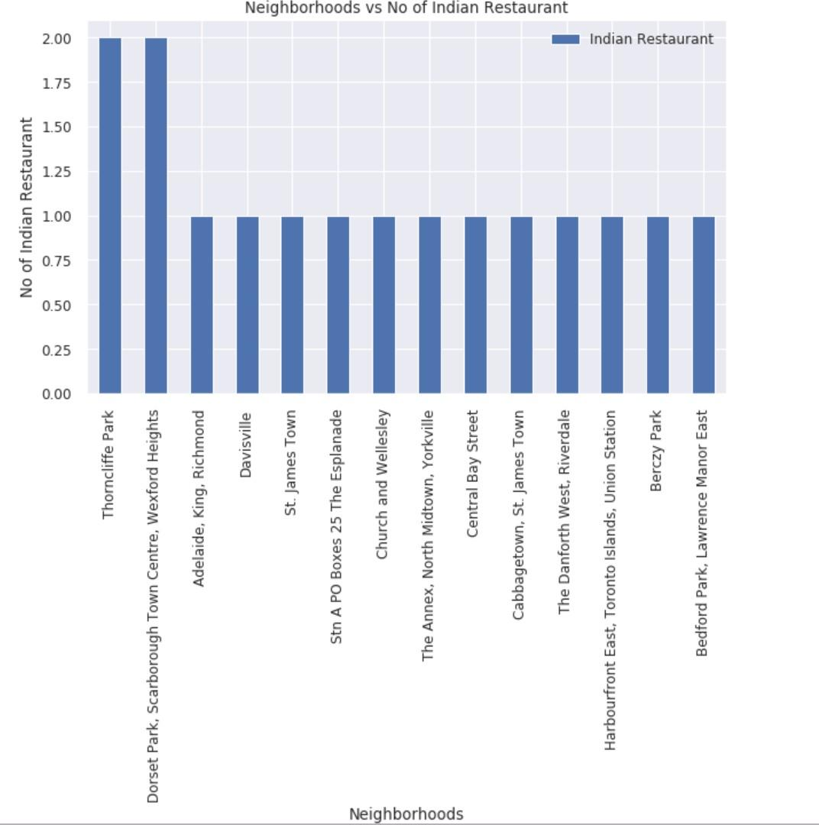
Visualize the neighbourhood with Indian Restaurants

Slide 11
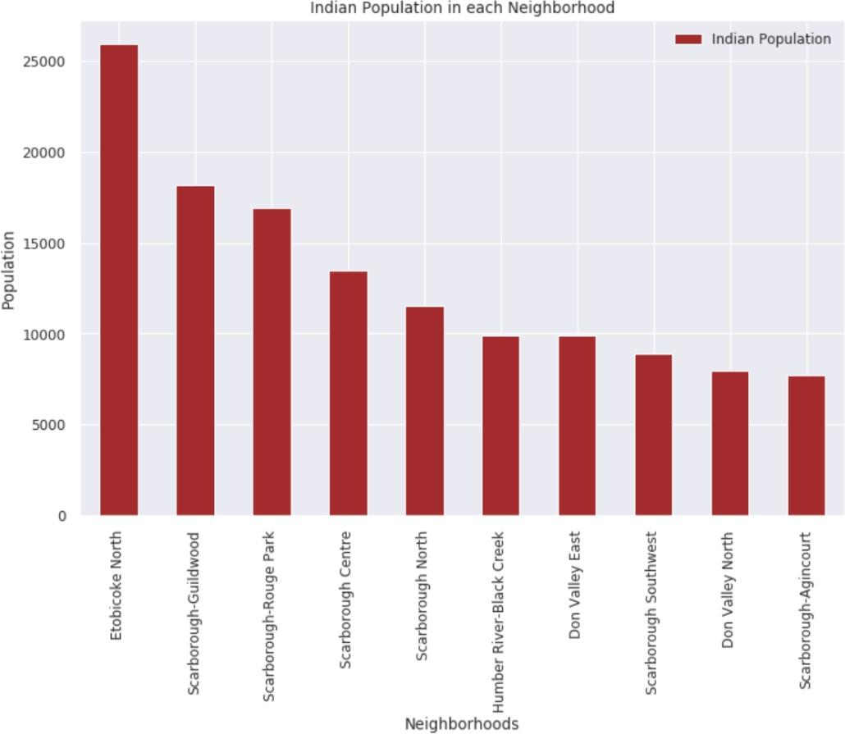
Visualize the population spread in neighborhoods
This analysis & visualization of the relationship between neighbourhoods & Indian population present in those neighbourhoods helps us in identifying the highly populated Indian neighbourhoods. Once we identify those neighbourhoods it helps us in deciding where to place the new Indian restaurant.

Slide 12
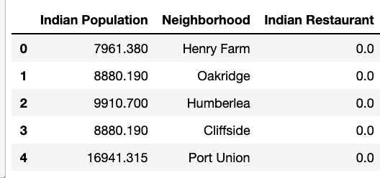
Relationship between Indian population and Indian restaurant
After performing the data cleaning & data analysis we couldn’t identify a big relationship established between densely populated Indian neighborhoods & number of Indian restaurants. This might be because of the missing in data as this an area which can improved in future analysis to get a more insight about the business problem.

Slide 13
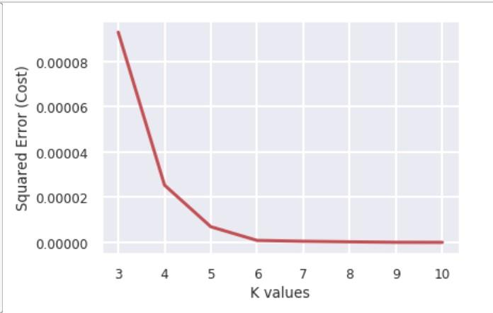
Clustering Neighbourhoods of Toronto
First step in K-means clustering is to identify the best K value meaning the number of clusters in a given dataset. To do so we are going to use the elbow method on the Toronto dataset with Indian restaurant percentage.

Slide 14
Conclusion
Finally to conclude this project, We have got a chance to on a business problem like how a real like data scientists would do. We have used many python libraries to fetch the data , to manipulate the contents & to analyse and visualize those datasets. We have made use of Foursquare API to explore the venues in neighbourhoods of Toronto, then get good amount of data from Wikipedia which we scraped with help of Wikipedia python library and visualized using various plots present in seaborn & matplotlib. We also applied machine learning technique to predict the output given the data and used Folium to visualize it on a map.
Some of the drawbacks or areas of improvements shows us that this analysis can be further improved with the help of more data and different machine learning technique. Similarly we can use this project to analysis any scenario such as opening a different cuisine restaurant or opening of a new gym and etc. Hopefully, this project helps acts as initial guidance to take more complex real-life challenges using data-science.

Slide 15
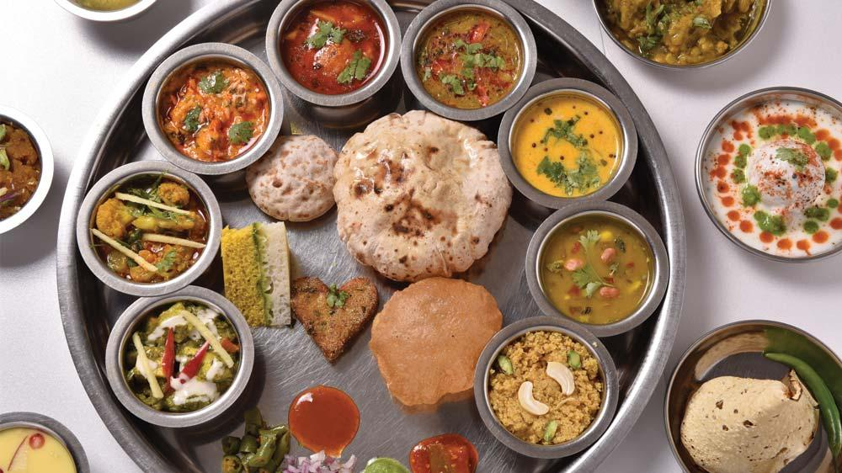
Thank you

